Slide 1

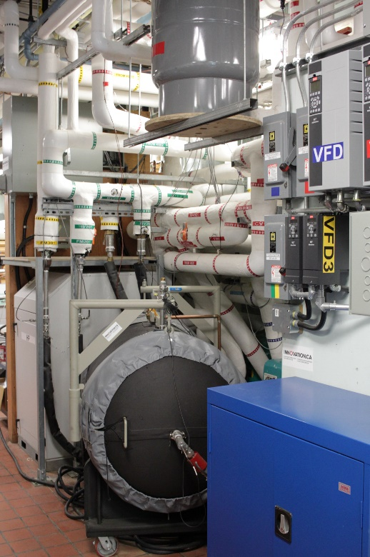
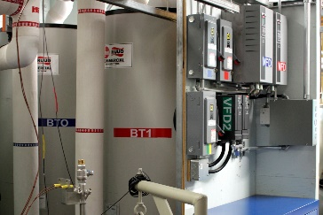
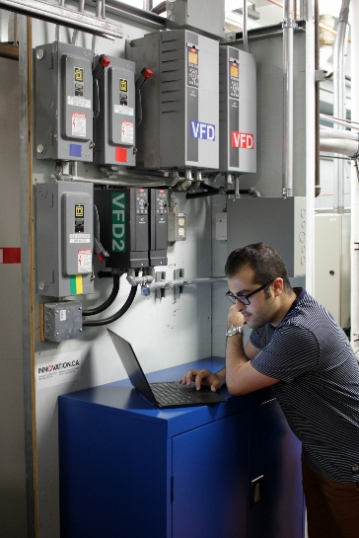

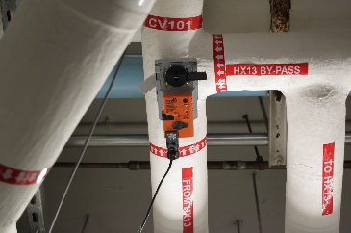
ANNEX 67 NEWS
Content
02 Brief from the 7th working meeting in Annex 67
03 Open workshop in Montreal, Canada
04 Canadian perspective on energy flexibility
06 Summary report "Review of applied and tested control possibilities for energy flexibility in buildings“
07 PVopti
08 Test facilities at Polytechnique Montréal
08 National projects: FIRST (PT) and SRI Austria (AT)
09 Next IEA Annex 67 meetings
09 Energy flexibility related events
The Semi-Virtual Laboratory at Polytechnique Montréal
Photo by Michaël Kummert

Slide 2
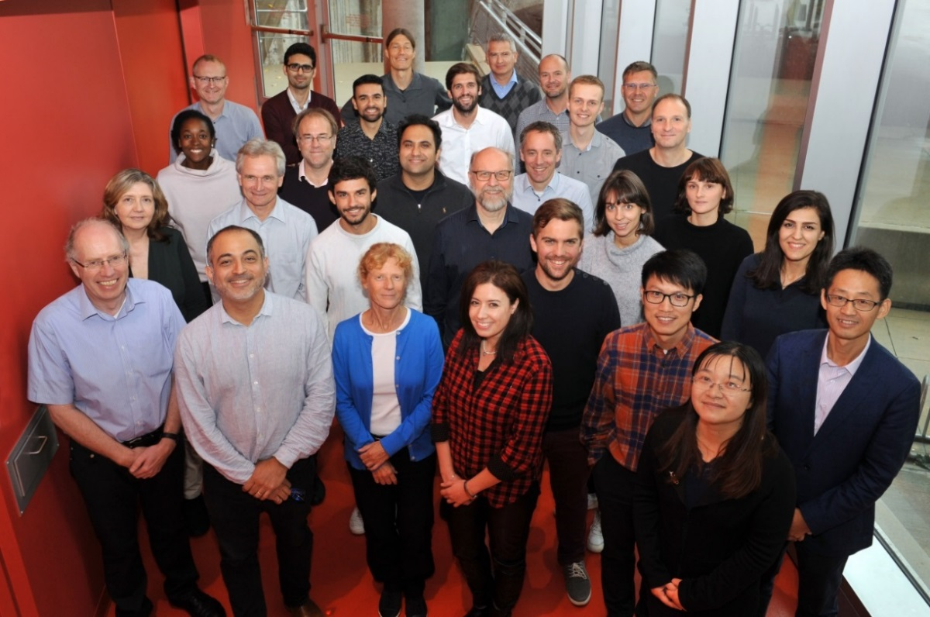
Brief from the 7th Annex 67 working meeting
By Søren Ø. Jensen, DTI & Anna Marszal-Pomianowska, AAU, Glenn Ryenders, VITO
A seventh working meeting took place in Montreal, Canada on October 10th-12th, 2018. The meeting was attended by 34 participants from 12 countries. The meeting was hosted by Polytechnique Montréal.
The main part of the meeting was used to focus on defining the content and authors of the Annex 67 Deliverables. Compared to the original plans the number of deliverables was reduced by one as two deliverables were merged. Due to the work of the annex, the content of the deliverables have changed, which has let to slightly new titles that better express the content of the deliverables. The deliverables from Annex 67 will be:
Principles of Energy Flexible Buildings
Characterization of Energy Flexibility in Buildings
Stakeholders’ perspective on energy flexible buildings
Control strategies and algorithms for obtaining energy flexibility in buildings
Experimental facilities and methods for assessing energy flexibility in buildings
Examples of Energy Flexibility in buildings
Project Summary Report
Many other publications (reports, articles, papers and a calculation tool) may already now be found on annex67.org/Publications
During the Annex 67 project a generic characterization methodology for energy flexibility has been developed – see Annex 67 Newsletter no. 4. For energy flexible systems (e.g. a building) that are controlled to react to a penalty signal (e.g. price), the methodology defines flexibility characteristics derived from the response of a system to a step change in the penalty signal or a temporal penalty signal varying over the year. Two approaches have been introduced in the Annex to compute the flexibility characteristics: a data-driven approach whereby system identification techniques are used to identify the response function based on time series data of the system output (e.g. energy use) and the penalty signal; and a simulation-based approach whereby the flexibility characteristics are derived from simulating the system response to respectively a flat penalty and a step penalty.
By means of common exercises and an intensive “sprint week”, annex participants have put the developed methodology to a series of tests to evaluate its applicability and sensitivity to boundary conditions, shape and size of the penalty signal, initial conditions, etc. The focus was on the simulation-based approach. While showing significant dependence of the flexibility characteristics to these circumstantial variables and the ability of the method to reflect this dependence for specific buildings, the study concluded that given a precise description of the calculation procedure, the methodology could be applied for inter-building comparison as well.
An Excel tool for providing a standardized way for communicating results from the two approaches of the methodology (data driven or simulation based) has been developed.
The participants of the 7th working meeting of Annex 67

Slide 3
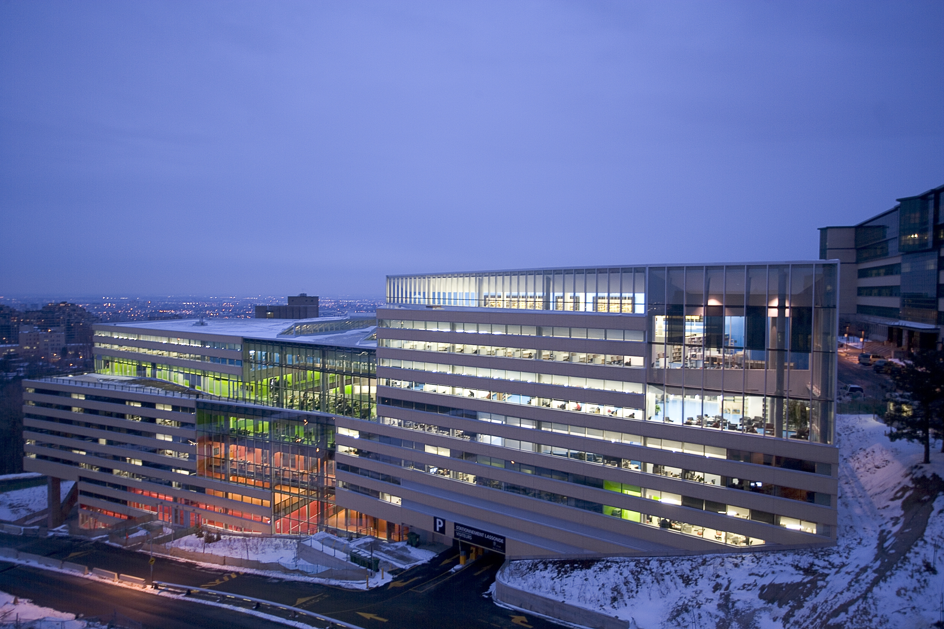
Open workshop in Montréal, Canada
By Michaël Kummert, Polytechnique Montréal
A public seminar was organized at Polytechnique Montréal with the support from Institut de l’Énergie Trottier (http://iet.polymtl.ca/en/). The half-day seminar took place on Friday October 12, right after the 7th working meeting. The objective was to provide an overview of EBC Annex 67 activities and achievements to a broader Canadian audience, and to give an opportunity to various Canadian stakeholders to present their work related to energy flexibility. The event attracted a wide audience from universities, public and private research laboratories, energy services companies and utilities, consulting engineering firms, and architecture firms, among others.
Michaël Kummert started the workshop by welcoming the participants and presenting the Annex 67 project in the context of IEA activities and the Energy in Buildings and Communities programme. He presented a quick overview of the Canadian context (see “Canadian perspective on energy flexibility” in this newsletter).
Søren Østergaard Jensen (DTI, OA for Annex 67) presented the Annex objectives, tasks, and current status. He also provided an overview of other IEA activities regarding demand flexibility and renewable energy sources integration. Achievements of Annex 67 include a definition for energy flexible buildings and Key Performance Indices (KPIs) to assess flexibility, which had not been formalized before. Søren also presented the links between EBC Annex 67 and related European initiatives such as the Smart Readiness Indicator in the European EPBD
Rune Grønborg Junker (DTU, PhD) provided an overview of the concepts and conclusions presented in a recently published paper (“Characterizing the energy flexibility of buildings and districts”, see Annex 67 publication list http://www.annex67.org/publications/).
Kun Zhang and Behzad Barzegar (Polytechnique Montréal) presented their work to assess energy flexibility of a typical Canadian single-family home (equipped with electric heating, as is common in Québec). Kun assessed the flexibility potential by adapting the heating setpoint through reactive and predictive control strategies, using the thermal mass present in the building. The method has an impact on thermal comfort but allows to provide several kWh of flexible energy for 1-h events without requiring any hardware investments. Behzad presented the results obtained for the same house equipped with a Photovoltaic (PV) + battery system. Self-consumption and self-generation were assessed for various system sizing options, and the flexibility obtained under different control strategies (grid support or uninterrupted power supply) was assessed. The system can deliver several kWh of energy flexibility for 1-h events, without affecting the occupants thermal comfort or their ability to use electrical appliances. In both cases (thermal mass and PV-Battery), flexibility depends on the event duration and its timing (time of the day, season, temperature and solar radiation).
Alexi Miller (New Buildings Institute, USA) then provided an overview of the GridOptimal initiative, which aims at defining a new metric for building-grid interaction. The electric grid must cope with an increasing share of intermittent renewable energy sources, and this requires buildings that “behave as good grid citizens”, providing energy flexibility. The GridOptimal initiative was developed independently of Annex 67, but Alexi took part to the working meeting and Annex 67 concepts will be considered in moving the GridOptimal project forward.
Andreas Athienitis (Concordia University, Montréal) presented the National Science and Engineering Research Council (NSERC) / Hydro-Québec Industrial Research Chair in Optimized Operation and Energy Efficiency, which aims at developing Model Predictive Control (MPC) for responsive building operation, energy flexibility, and application to case studies.
The public seminar took place in the Lassonde buildings at Polytechnique Montréal. © Productions Punch Inc.

Slide 4
Andreas focused on an application to the Varennes public library, a building that was designed to reach Net-Zero Energy performance. Building-Integrated PV/Thermal collectors and building thermal mass (e.g. floor heating) can be controlled to promote flexibility, thanks to an MPC strategy relying on low-order simplified models. Andreas also provided an overview of an upcoming Canadian strategic research network (Smart Solar Buildings and Communities, SSBC). The project is currently at the proposal stage. If funded, the network will see 26 researchers join forces to address several research themes, from system design and modelling to operation strategies for energy flexibility and input to national policy.
Michaël Fournier (Hydro-Québec Research Institute, IREQ) presented the perspective of a major Canadian utility. Hydro-Québec has a generation capacity of 37 GW and annual sales of 205 TWh. Although Hydro-Québec can rely on hydroelectric power plants with storage for most of its production, there is an interest to promote demand response and energy flexibility. The company is providing voluntary Demand Response options to industrial and commercial/institutional customers, and is considering adding a residential option. It has led several pilot projects to assess flexibility with electric space heating and domestic water heating.
Véronique Delisle (CanmetENERGY Varennes, QC, Canada) provided an overview of the Canadian federal government’s demand flexibility Research and Development activities. Véronique presented several flexibility indicators for Canada (see “Canadian perspective on energy flexibility” in this newsletter), and then focused on case studies in the residential sector. The potential of controlling smart thermostats for peak shaving was assessed in a pilot project in Sherbrooke, QC. Maximum flexibility reached 15 kW for houses heated with electric baseboards, and occupants were largely satisfied
with the thermal comfort, except for some preheating events in bedrooms.
Another project in Prince Edward Island demonstrated the effectiveness of using storage water heaters to provide flexibility and increase the share of locally used wind energy in the electric grid.
The public seminar provided a variety of perspectives on energy flexibility, from within and outside the Annex 67 group, and allowed to disseminate some of the key achievements of Annex 67. The event was very well received, and discussions continued among participants and Annex 67 researchers during the reception which closed the seminar and the Annex 67 working meeting.
The public seminar presentations are available at: http://iet.polymtl.ca/en/events/energy-flexible-buildings-public-seminar/
Canadian perspective on energy flexibility
By Michaël Kummert, Polytechnique Montréal
Generation mix and CO₂ intensity of electricity: regional differences
Canada is a vast country, and there are strong differences between Provinces (or even within Provinces) in terms of how the electric grid is supplied and which demands it has to meet. Nationally, the share of renewable energy in the electricity mix is just below 2/3, at 66 % [1], and the CO₂ intensity is 140 g/kWh. But the CO₂ intensity ranges from a low of 1 g/kWh in Québec (QC) to a high of 790 g/kWh in Alberta (AB). The Figure 1 shows the energy generation mix for Canada and for 5 major regions. Due to large differences in climate and building sector characteristics, the demand profiles and grid capabilities to respond to peak demands are very different, cf. Figure 2.
Figure 1. Electricity generation mix in Canada and main regions – data from 2016 [1]

Slide 5
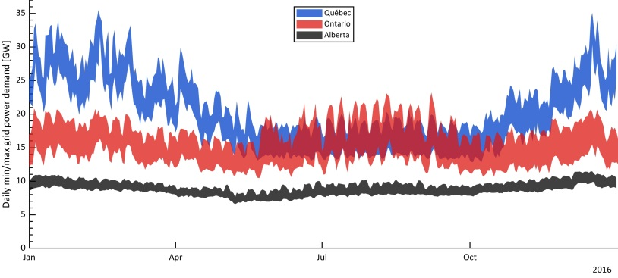
Rapidly changing electric supply and demand: a higher need for flexibility
The need for flexibility due to renewable energy input is relatively minor, especially considering that reservoir hydro power plants are available to quickly compensate for wind and solar fluctuations. However, electric grids are changing, both from the generation point of view and from the demand point of view. Ontario, for example, has eliminated coal from its electricity mix between 2003 and 2014, going from 25 % of the supply mix to 0 %, and phasing out almost 8 GW of capacity. Across Canada, the annual generation from wind power went from 1.6 TWh/y to over 30 TWh/y, and the generation from solar went from 0.02 TWh/y to 3 TWh/y between 2005 and 2016. This trend is expected to continue.
At the same time, the National Energy Board anticipates that Electric Vehicles (EVs) will have a higher market penetration in the near future, and that heat pumps will replace existing oil-fired and gas-fired space and water heating systems [1]. The larger penetration of intermittent renewables and the larger use of electricity for transportation, space and water heating in buildings will result in an increased need for flexibility. Decentralized generation is also encouraged by building codes and voluntary certification schemes such as LEED, which encourage net-zero energy or net-zero energy construction. As part of the Pan-Canadian Framework on Clean Growth and Climate Change, the federal and provincial energy ministers have adopted Canada’s Building Strategy, which aims at developing and adopting a “net-zero energy ready” building code by 2030 [2]. There is currently no national framework for flexibility, but most major utilities and Independent System Operators are implementing various types of demand-response measures, from interruptible loads to time-varying rates and peak demand charges with incentives for customers providing energy flexibility to the grid.
Natural Resources Canada has assessed “smart grid deployment metrics”: higher penetration of renewables, higher penetration of EVs (over 72000 EVs with about 7000 charging stations in 2018), strong penetration (81 %) of smart meters [3].
The Research and development projects presented at the Annex 67 public seminar show a strong interest from various stakeholders to implement and assess flexibility measures. Successful pilot projects have demonstrated the benefits of energy flexible buildings to grid operators (see “Public seminar in Montréal, QC, Canada” in this newsletter). The reports and deliverables from Annex 67 come at the perfect time to provide guidance in developing an energy flexibility framework for Canada.
References
NEB, 2017a. Provincial & Territorial energy profiles. Calgary, AB: National Energy Board. https://www.neb-one.gc.ca/nrg/ntgrtd/mrkt/nrgsstmprfls/index-eng.html
Energy and Mines Ministers’ Conference, 2017. Build Smart – Canada’s Buildings Strategy, A Key Driver of the Pan-Canadian Framework. https://www.nrcan.gc.ca/buildsmart
Delisle, V. 2018. Overview of the federal government’s demand flexibility R&D activities. Presentation at the IEA EBC Annex Public workshop in Montréal, Oct. 12, 2018. http://iet.polymtl.ca/evenements/energy-flexible-buildings-public-seminar/
IESO, 2018. Power Data. Toronto, ON: Independent Electricity System Operator. http://www.ieso.ca/power-data
AESO, 2018. 2016 hourly load data. Calgary, AB: Alberta Electric System Operator. https://www.aeso.ca/market/market-and-system-reporting/data-requests/2016-hourly-load-data/
Régie de l’énergie Québec, 2018. Relevé des livraisons d’énergie en vertu de l’entente globale cadre pour la période du 1er janvier 2015 au 31 décembre 2015. http://www.regie-energie.qc.ca/audiences/Suivis/Suivi_HQD_D-2013-206.html
Figure 2. Daily min and max power demand on 3 provincial grids [4,5,6]

Slide 6
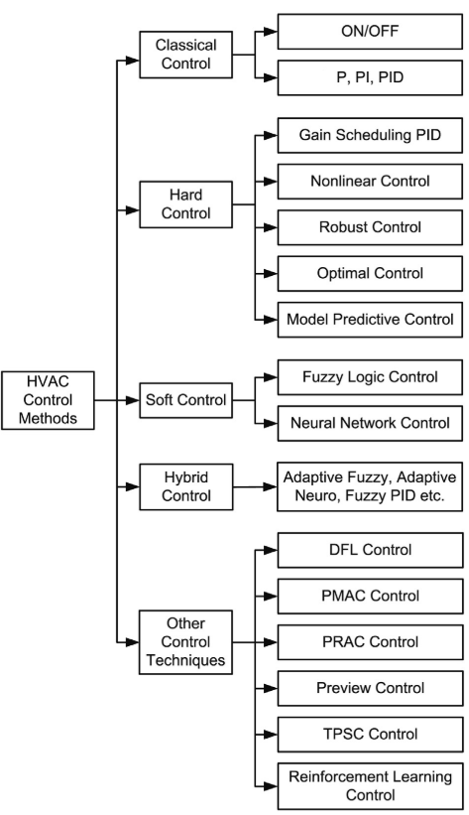
Summary report "Review of applied and tested control possibilities for energy flexibility in buildings“
By John Clauß, NTNU
The report reviews control strategies that aim at shifting the building energy demand by making use of the energy flexibility with a focus on heating loads under changing ambient conditions. The conditions vary due to weather, occupancy and other factors that can affect control. Control strategies and metrics are considered for both, standalone buildings as well as their interaction with the energy system.
Section 1 gives an overview of typical building energy use emphasizing their dependency on the building type, occupants and context. Specificities of both energy vectors and energy systems are introduced. Two energy systems, electrical grid and district heating, are described and the role of demand response and energy flexibility is introduced. A full definition of energy flexibility is difficult to obtain, since researchers with different academic backgrounds may have different views on energy flexibility. A short overview of definitions is given:
Energy flexibility can be seen as the ability to manage a building’s demand and generation according to local climate conditions, user needs and grid requirements.
It can also be understood as a building property, if it is seen as the margin in which the building can be operated while respecting its functional requirements (Clauß, Finck, Vogler-Finck, & Beagon, 2017).
On the other hand, energy flexibility can be regarded as a service, which can be provided. In that sense, energy flexibility will allow for demand side management/load control and demand response based on the requirements of the surrounding grids.
Section 2 reviews control strategies, opening with control definitions and a critical review of control methods. Common control objectives for demand response studies are (1) peak shaving, (2) reducing energy costs, and (3) improving the use of electricity from renewable energy sources. The section explores in more detail studies on the potential for optimizing building energy use through model predictive control as well as by applying reinforcement learning. Finally, three building modelling and simulation approaches are described (white-box, grey-box, black-box) together with advanced mathematical techniques for control and decision making.
Section 3 reviews metrics and indicators to evaluate the influence of control strategies regarding energy flexibility.
Figure 3. Overview of control methods for building HVAC systems (Afram & Janabi-Sharifi, 2014).
It distinguishes between voluminous monitoring data, computed metrics and high-level KPIs. Metrics and indicators are allocated to three categories:
(1) building energy performance, (2) building energy flexibility, and (3) building interaction with its energy system. Energy system (grid) metrics used by transmission and distribution system operators are presented alongside building energy metrics. The contrast is important to understand potential field use of energy flexible buildings (Finck et al., 2018).
References
Afram, A., & Janabi-Sharifi, F. (2014). Theory and applications of HVAC control systems - A review of model predictive control (MPC). Building and Environment, 72, 343–355. https://doi.org/10.1016/j.buildenv.2013.11.016
Clauß, J., Finck, C., Vogler-Finck, P., & Beagon, P. (2017). Control strategies for building energy systems to unlock demand side flexibility – A review. In 15th International Conference of the International Building Performance Simulation Association, San Franciso, USA. San Francisco.
Finck, C., Clauß, J., Vogler-Finck, P., Beagon, P., Zhang, K., & Kazmi, H. (2018). Review of applied and tested control possibilities for energy flexibility in buildings Review of applied and tested control possibilities for energy flexibility in buildings. https://doi.org/10.13140/RG.2.2.28740.73609

Slide 7
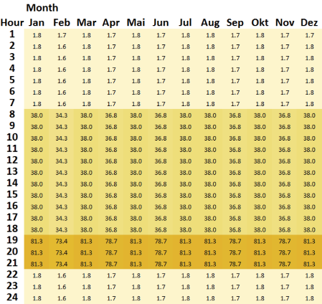
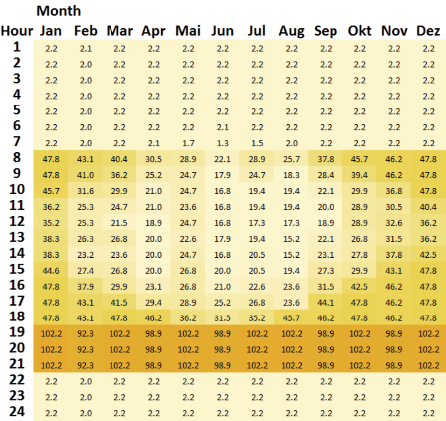

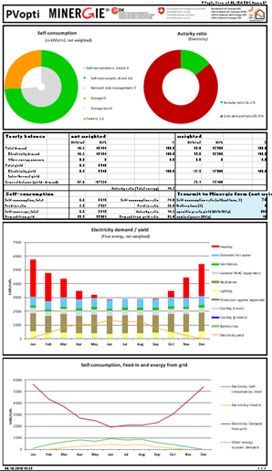
PVopti
By Monika Hall, Institute of Energy in Buildings, University of Applied Sciences and Arts Northwestern Switzerland (FHNW)
PVopti is an hourly-based MS Excel-too, developed to evaluate variations in self-consumption in the (early) design phase with reasonable accuracy and cost. It is an easy-to-use and freely available tool which can be used for most building types. The tool respects common heating systems, the main energy demands and on-site electricity generation by photovoltaics and combined heat and power. Electricity storage can be included as well as demand side management.
The input requires annual or monthly values and the distribution to hourly values is done automatically according to the following:
The Swiss guideline SIA 2024 [1] are used to distribute Load profiles for appliances and artificial lighting For artificial lighting, a criterion for daylight is added. If the horizontal global radiation exceeds 200 W/m², artificial lighting is off. This shifts the artificial lighting demand towards evening hours and wintertime to a large degree.
Figure 4. Annual distribution of artificial lighting without (top) (SIA 2024) and with (bottom) the additional daylight criterion [2].
The distribution of heating and cooling demand depends on the ambient temperature. Taking the thermal mass of the building into account, the moving average of the last 24 hours is used. The heating limit is 12 °C referring to the moving average and 16 °C for cooling. The cause for the low cooling limit is climate data with low temperatures. If the cooling limit is 21 °C, climates with low temperatures won’t reach the limit on a moving average. In this case, cooling is not taken into account.
The domestic hot water distribution is correlated to the presence of persons.
Ventilation and general HVAC equipment have constant loads for every hour in the year. In non-residential buildings the ventilation correlates with the presence of persons.
The distribution of PV-yield and the yield of a thermal collector depend on the hourly radiation values from the site climate data.
Demand side management is possible as follows:
The heat pump run time can be scheduled for day+night (00:00-24:00), day time (6:00-17:00) or night time (17:00-6:00).
For residential buildings load shifting is possible. A maximum of 2% of the demand of appliances, artificial lighting and general HVAC can be shifted into daytime.
A battery storage is implemented but without any special control. No seasonal storage is possible. The storage is always empty at the beginning of the year.
A seasonal thermal storage is not available.
PVopti has been validated with seven building topologies. For validation purposes, calculations done with and measurement results are compared for seven buildings. The agreement of measured and calculated values is quite good for the residential buildings. The kindergarten shows a higher deviation. One reason could be a result of missing discrete data for demand and production due to the balancing metering system. Some additional simulations would be necessary to generate the necessary data. The use of the Minergie standard values for the category “School” for kindergartens may be another issue.
For the purpose of the IEA EBC Annex 67, PVopti was extended to allow for bespoke climate data. Location and the hourly values for ambient temperature and horizontal global radiation can be inserted. Due to this extension, the tool can be used for buildings all over the world. The PVopti Annex 67 version is available on the Annex 67 website.
References:
[1] Merkblatt SIA 2024:2015: Raumnutzungsdaten für Energie- und Gebäudetechnik
[2] Burger B., Hall M.: PVopti – hourly based energy balance for building design. Energy Procedia 122 (2017), p. 769-774, CISBAT 2017, Lausanne CH
Figure 5. Input and result page.

Slide 8
Test facilities at Polytechnique Montréal
By Michaël Kummert, Polytechnique Montréal
The Semi-Virtual Laboratory at Polytechnique Montréal allows to test hydronic (water-side) heating and cooling equipment in highly dynamic conditions. Active (e.g. heat pumps) and passive (e.g. storage tanks) equipment can be tested thanks to auxiliary loops capable of producing and rejecting up to 100 kW of heat simultaneously. A key feature of the Semi-Virtual Lab is to perform Hardware-In-the-Loop testing, where HVAC equipment is tested in realistic operating conditions provided by a full system dynamic simulation with the TRNSYS program. The 2-way data exchange between LabVIEW and TRNSYS is performed at every time step through shared variables, allowing direct feedback from the experimental performance on the simulation results and vice-versa.
The objective of the Semi-Virtual Lab is to develop and validate detailed dynamic models of HVAC equipment including detailed controls, and to test new prototypes or existing equipment in realistic dynamic conditions to improve their design and standard testing methods. Testing equipment in highly dynamic and realistic operating conditions is a key aspect for energy flexibility, as the building has to react quickly to grid signals to store or de-store heat. Standard testing procedures are often based on steady-state or pseudo-steady-state operating conditions, which leads to models and performance data well suited for long-term energy performance analyses but often not adapted to energy flexibility studies. One typical example is advanced compact storage devices including Phase-Change Materials: as part of an energy flexible building, these storage devices must be able to respond quickly to multiple (and
possibly incomplete) charge/discharge cycles at different operating temperatures.
Simple models based on slow and complete charge/discharge cycles at nominal operating temperatures are typically not accurate for more dynamic operating conditions.
TRNSYS simulations predict system performance, calculating the flowrates and temperatures of the fluid streams entering HVAC equipment under test, which are used as actuator control signals in the Laboratory. The equipment’s response to these operating conditions is sensed in the laboratory and imposed back on the building simulation. Dynamic operating conditions are imposed on the tested equipment (e.g. a heat pump, as in the Figure 6) based on a full system simulation. Measured outlet conditions (in this case temperature and flowrate on the source and load sides) at a given time step are sent to the simulation, which then calculates the inlet conditions for the next time step.
More information on the Semi-virtual laboratory and examples of previous studies related to energy flexible buildings are available in the Annex 67 report on Laboratory facilities used to test energy flexibility in buildings: http://www.annex67.org/publications/reports/
National Projects
SRI Austria - Smart Readiness Indicator: Rating scheme and opportunities for smart buildings
By Armin Knotzer, AEE INTEC
SRI Austria is an ongoing Austrian project with stakeholder interviews on the "smartness" of buildings, a technology screening, impact analysis and classification of possible technologies/services plus master's theses. It forms the basis of a proposal for the national implementation of the "smart readiness indicator” of buildings and accompanying measures in Austria. In coordination with the Austrian Institute of Construction Engineering, regional and national governmental representatives, and in cooperation with the IEA EBC Annex 67, the responsible persons of the EU DG Energy, the VITO consortium and the national stakeholders, the proposal of a SRI Austria will be developed.
Austrian technology and energy service providers, experts and other relevant stakeholders will be asked about their opinion and the potential of smart building technologies within workshops and interviews.
Figure 6. Semi-virtual testing principle showing the interaction between the hydronic test bench and the TRNSYS simulation through LabVIEW.

Slide 9
Furthermore, interesting business models, which already build on intelligent building technology, or which exist in the field of digitization of the energy system, are examined. 5 master thesis will be involved to help in the indicator discussion with building simulations on smart technologies, in the stakeholder process and in the market and impact analysis. The main result is a basis for decision-making and support for the national political implementation of an SRI Austria and a possible integration into the energy certification system.
Project leader:
AEE - Institute for Sustainable Technologies (AEE INTEC)
Project partners: 17&4 Organisationsberatung, Technology platform Smart Grids Austria, University of Applied Sciences FH Technikum Wien
Project timeframe: July 2018 to October 2019
Project sponsor: Austrian Ministry of Transport, Innovation and Technology
Project webpage: https://nachhaltigwirtschaften.at/en/sdz/projects/sri-austria.php
FIRST: Mapping flexibility of urban energy systems
By Daniel Aelenei, Universidade Nova de Lisboa
Despite of the lack of insight into how much Energy Flexibility different types of building and their usage may be able to offer to the future energy systems, there is general agreement that changes in electricity use may lead to increased or decreased peak demand from building – and therefore increase/decrease the value of flexibility to reduce peak loads in the local grid. For these reasons, the team of the FIRST project decided to set out a research project to examine the potential for energy flexibility at a level of an existent neighbourhood in Lisbon in order to find to what extent the provision of flexibility from the consumer side could be facilitated. It begins with the estimation of shifting potential of volumes of electricity consumed for short or long periods of time at individual level of buildings as a response to grid tariffs and/or renewable availability. It then draws on the distribution to urban energy systems encompassing a larger chain of buildings within the neighbourhood domain to estimate the potential for energy flexibility at the community level. Given the breadth and complexity of this research topic, the team will focus the inquiry on a number of three hierarchically related research activities:
A. Study of potential for energy flexibility at individual building level (load shifting of typical buildings)
B. Study of potential for energy flexibility at community level (load shifting with algorithms)
C. Mapping out the potential.
The major goal of this project is to unleash the energy flexibility potential of demand response measures at a time when buildings are becoming prosumers. The focus of research is the understanding of the costs associated with generation and consumption in different scenarios and the mapping of the potential for flexibility in a visual form. The major advantage of this research lies in the fact that it uses real data of energy systems and energy demand profiles collected within the frame of another MIT project (SUSCITY ­ http://groups.ist.utl.pt/suscity­project/inicio/) where building characteristics, utilization and occupation patterns and energy consumption were obtained among other features to identify a set of building types which are able to correctly represent the urban built environment – archetypes.
Project leader: Center of Technology and Systems
Project partners: IN+ Center of Inovation and National Laboratory of Energy and Geology Project sponsor: Portuguese Foundation for Science and Technology within the frame of the MIT Portugal Program (MIT-EXPL/SUS/0015/2017)
Project webpage:http://in3.dem.ist.utl.pt/first/
Next IEA EBC Annex 67 meetings
IEA Annex 67 8th expert meeting – April 2019, Aalborg, Denmark
Energy flexibility related events
Indoor Air 2020
July 20-24, 2020
Seoul, South Korea
8th International Building Physics Conference (IBPC )2021
June/August 2021
Copenhagen, Denmark
IEA EBC ANNEX 67
Energy Flexible Buildings
Operative Agent: Søren Østergaard Jensen
sdj@teknologisk.dk
Website: Annex67.org
Participating countries:
Austria, Belgium, Canada, China, Denmark, Finland, France, Germany, Ireland, Italy, Netherlands, Norway, Portugal, Spain, Switzerland, UK

